Slide 1
Gradient descent

Slide 2
Gradient Descent
is an iterative optimization algorithm to find the minimum of a function.
  that function is our Loss Function
  in this case the Mean Squared Error cost function.

Slide 3

Linear Regression
Y = mX + c
Loss Function
  The loss is the error in our predicted value of m and c.
  Our goal is to minimize this error to obtain the most accurate value of m and c.

Slide 4
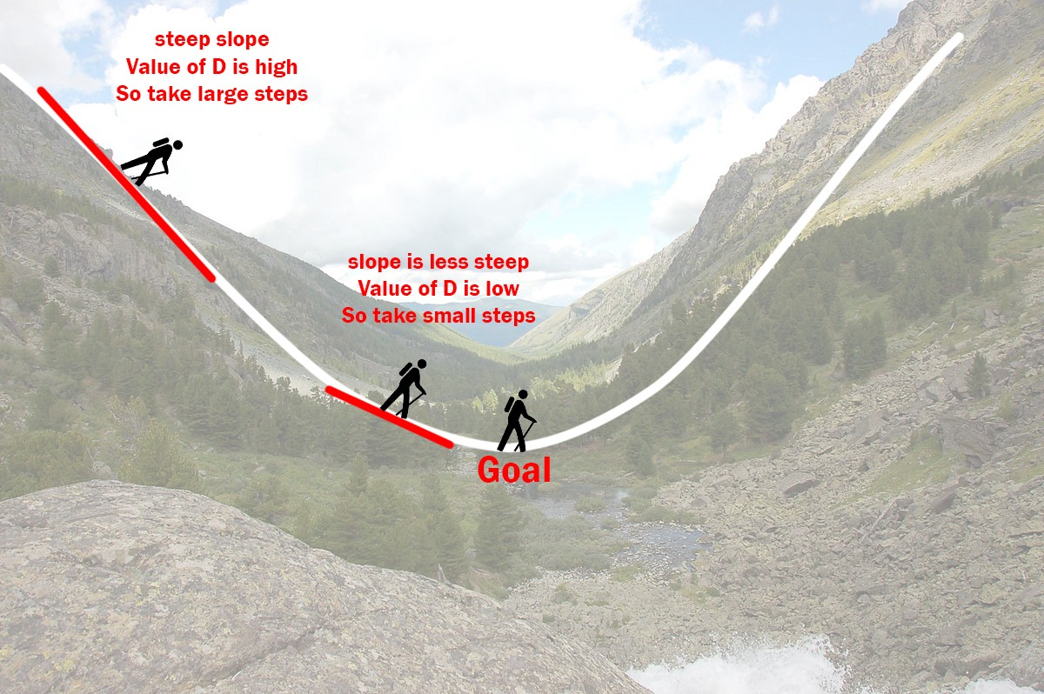
how the gradient descent algorithm works

Slide 5
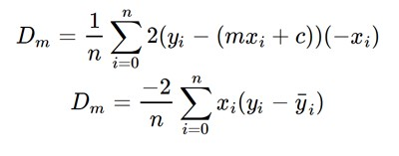
Applying gradient descent step by step
Initially let m = 0 and c = 0. Let L be our learning rate. This controls how much the value of m changes with each step. L could be a small value like 0.0001 for good accuracy.
Calculate the partial derivative of the loss function with respect to m,
  plug in the current values of x, y, m and c in it to obtain the derivative value D.

Slide 6

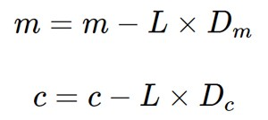
Similarly lets find the partial derivative with respect to c, Dc :
Now we update the current value of m and c using the following equation
We repeat this process until our loss function is a very small value or ideally 0 (which means 0 error or 100% accuracy).
  The value of m and c that we are left with now will be the optimum values.

Slide 7
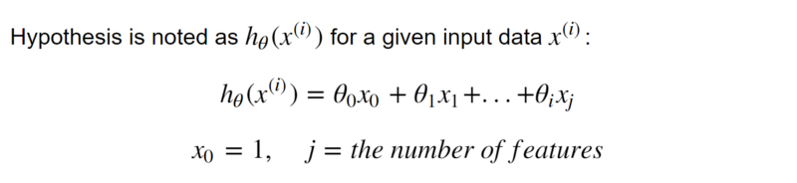
Linear Regression model
The hypothesis for Linear Regression model

Slide 8
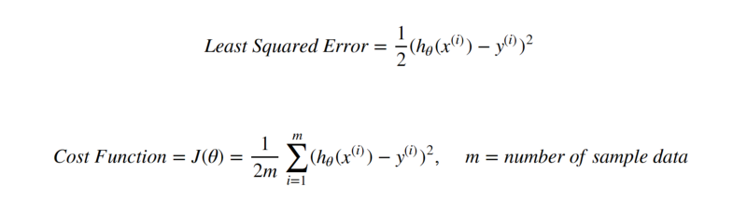
The most commonly used loss function for Linear Regression is
  Least Squared Error,
and its cost function is also known as
  Mean Squared Error(MSE).

Slide 9
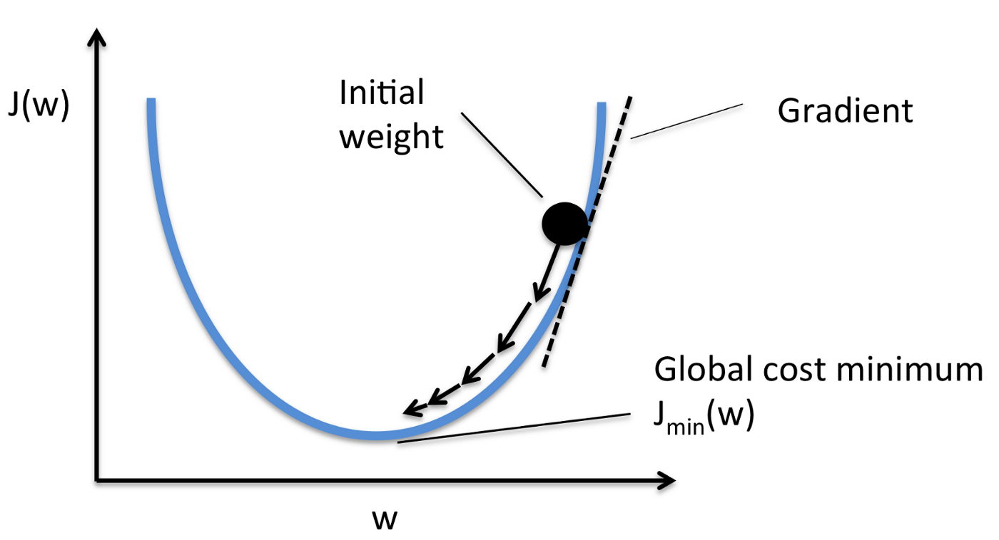
cost function is a parabola curve

Slide 10
To minimize it, we need to find its vertex of the parabola
One of the most popular programming solutions is Gradient Descent, to walk through the optimization process.
Gradient Descent is pervasively applied in different models
It takes steps based on a learning rate α, moving towards the vertex of the parabola
  which is also known as the point with the slope equals to 0.

Slide 11
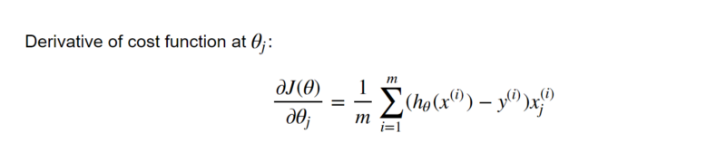
So to get the slope, we take the derivative of cost function at each coefficient θ.
Calculate the partial derivative of the loss function with respect to each coefficient θ

Slide 12
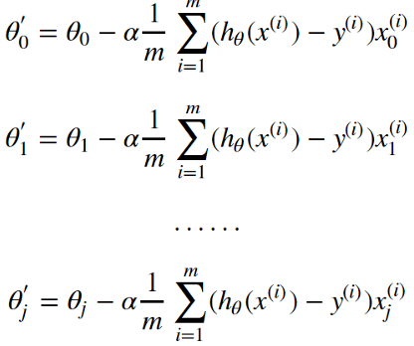
Next, continuously update each θ with a good amount of iterations along with the observation of reduction in cost function until it reaches a horizontal line.
In reality, it is impossible for the slope to reach an exact value of 0 due to the chosen step size, but it can be close to 0 as much as possible depending on hyperparameters.

Slide 13
Stochastic gradient descent
each training instance is shown to the model one at a time.
The model makes a prediction for a training instance,
the error is calculated and
the model is updated in order to reduce the error for the next prediction.
here gradient is the error for the model on the training data.

Slide 14
Types of Gradient Descent Algorithms
1. Batch Gradient Descent
2. Stochastic Gradient Descent
3. Mini-Batch Gradient Descent

Slide 15
Batch Gradient Descent
In the batch gradient descent, to calculate the gradient of the cost function,
  we need to sum all training examples for each steps
If we have 3 millions samples (m training examples) then the gradient descent algorithm should sum 3 millions samples for every epoch
To move a single step, we have to calculate each with 3 million times
Batch Gradient Descent is not good fit for large datasets

Slide 16
Stochastic Gradient Descent (SGD)
In stochastic Gradient Descent,
  we use one example or one training sample at each iteration instead of using whole dataset to sum all for every steps
SGD is widely used for larger dataset trainings
Computationally faster and can be trained in parallel
Need to randomly shuffle the training examples before calculating it

Slide 17
Mini-Batch Gradient Descent
It is similar like SGD, it uses n samples instead of 1 at each iteration.

